Slide 2

Making the world a better place?
Notes:
Phrases from the silicon valley show:
making the world a better place. Through constructing elegant hierarchies for maximum code reuse and extensibility."
make the world a better place through Paxos algorithms for consensus protocols,
make the world a better place through canonical data models to communicate between endpoints
making the world a better place through minimal message-oriented transport layers.

Slide 3

Introduction
Notes:
Does try to make the world a better place
supporting disaster relief organizations with open source software
Creating apps that map the spread of disease
Maintaining software that helps to optimize the delivery of relief supplies And more – No need to strat all over when time is criticall
Donate what you are good at – waste for programmers to paint fenses…

Slide 4
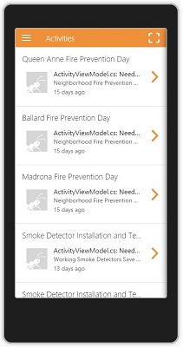


What is allReady?
Notes:
Topic: allReady is providing logistics and a platform for information feedback from disaster sites.

Slide 5
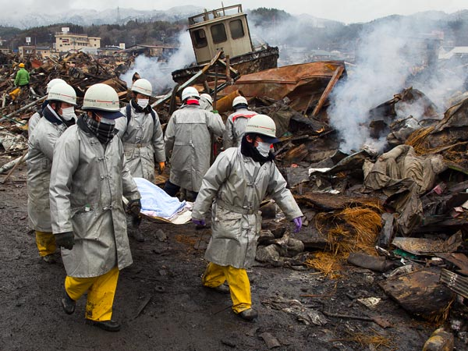
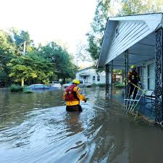
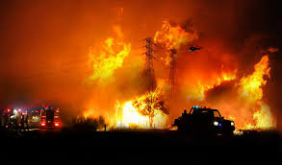
Why?
In every disaster scenario, new logistics are made to cope with the situation (non-immediate process).
Valuable (life-saving critical)
time is wasted in this process
Notes:
Have this slide a bit messy, to send an vibes of unease at this topic
*** Changed “The motives” to “why”

Slide 6
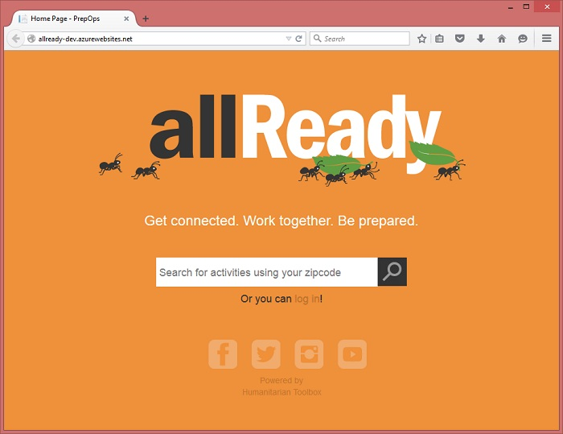
How?
Save valuable time:
A pre-made infrastructure of information and logistics, ready to be used at the time of need. Collaboration is established with emergency services with minimum latency.
Notes:
*** Changed “services prior to the incident” to “with minimum latency”
*** Changed “Solution” to “How”

Slide 7




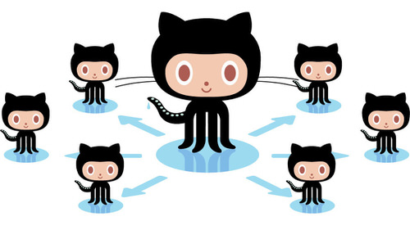
Who?
Team
Backed by
Contributing
Notes:
*** Changed “Backing” to “Backed by”

Slide 8





Means
Platforms
Tools
In accordance with
Notes:
Note: Red Cross and similar organizations are taking the role of “product owner”
*** Changed Image form android to Xamarin (Development is on Xamarin and hence can run on android IOS etc)

Slide 9
Feasibility
Current Milestone is version 1.0, due July 3, 2017 (46% complete as of mid-June)
Far from complete and ready for demonstration.
“After v1.5, we will fix issues identified in testing as well as focus on mobile support & apps for allReady. This milestone is currently be built and issues are being collected so it may be sparse for now.”
Milestones page
Notes:
Not fully ready yet, fixing bugs found in tests
### Is any software project ever fully ready? ☺

Slide 10
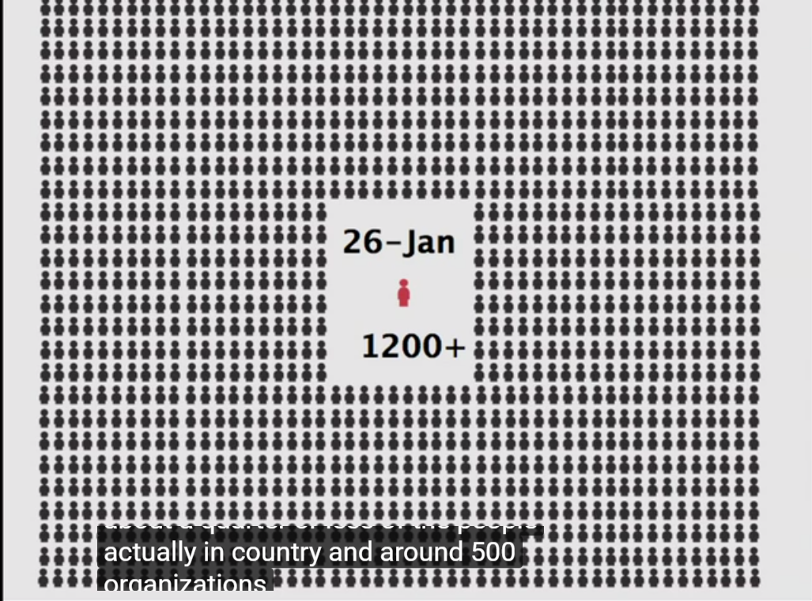
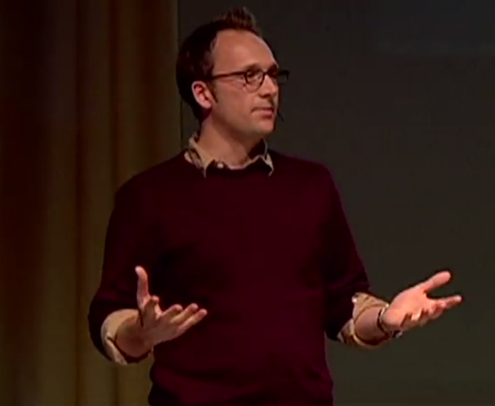
Feasibility
Though no demonstrations were made, the program does not lack the necessary backing for it to succeed.
Notes:
### Note: How do you make a POC for disaster handling? I guess starting a fire is out of the question … ☺

Slide 11
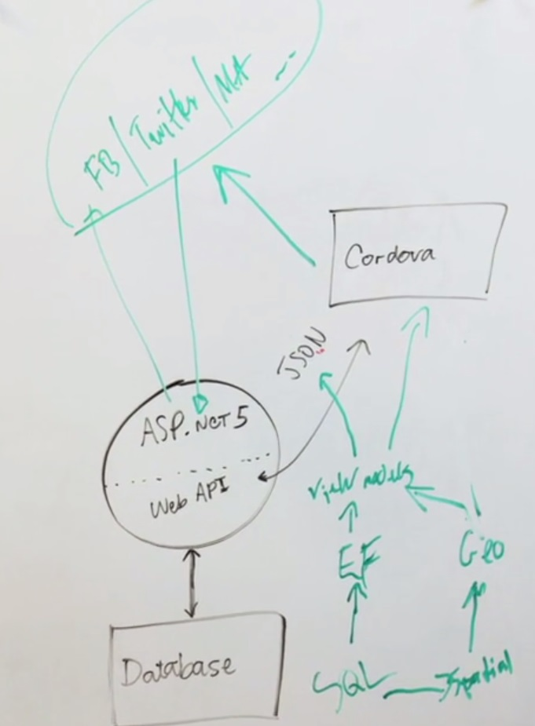
Model
Open Source
Developers:
Contributions from github community (through good will)
Core team, guided and advised by Microsoft experts
Development tools:
Data is saved on Azure servers, donated by Microsoft
Developed on Visual Studio, and various additive tools, also dedicated to the good cause by Microsoft
Notes:
***Note: “advised by Microsoft experts”: A strory I heard from a contributor – During a hackathon they had a dilemma regarding Time zones. Since Richard Campbell knows Jon Skeet (#1 ranked stackoverflow user: https://stackoverflow.com/users/22656/jon-skeet), as they are both Microsoft MVPs, which is working on the Noda-Time project (http://nodatime.org/) – They gave him a call and got instant support…

Slide 12
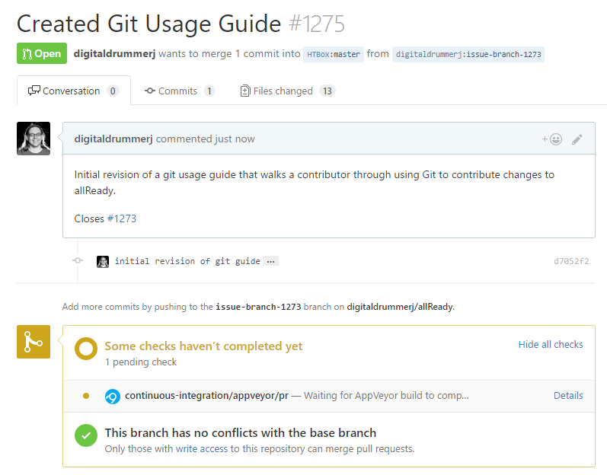
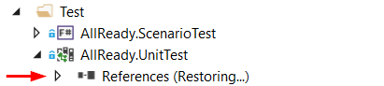
Documentation
Git Usage for already
Prerequisite Install Guide
Event instructions

Slide 13
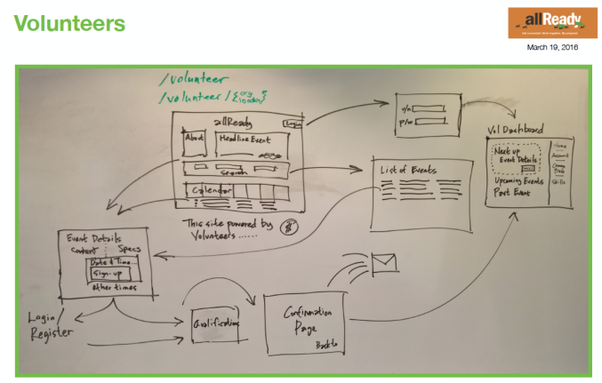
Design
Mostly driven by volunteers, runs on Azure database infrastructure
Notes:
*** Replaced “managed by an “ with “runs on ”

Slide 14
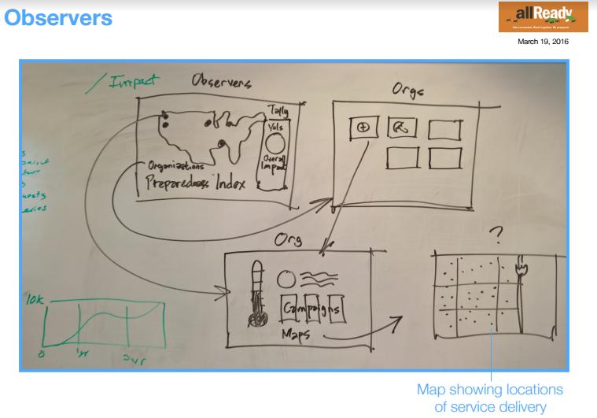
Features
Interface for volunteers;
Information gathering
Coordination
Data Management

Slide 15
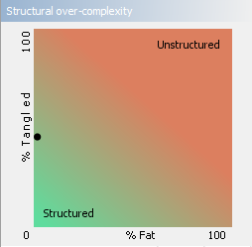
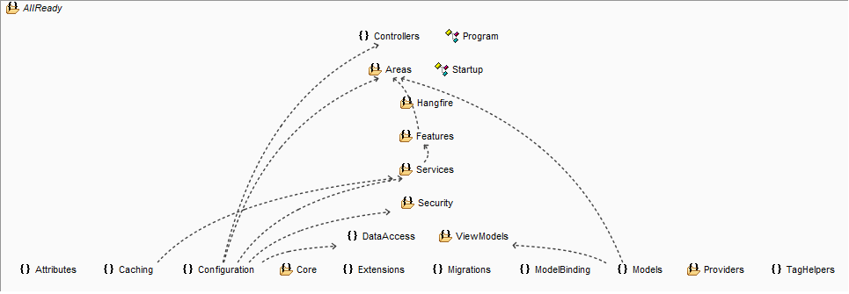
Features analysis
The code seems to be a bit tangled, though well-categorized.
allReady's app is sparse at its structure (reasonable for a project largely developed by volunteers), and is somewhat tangles.

Slide 16
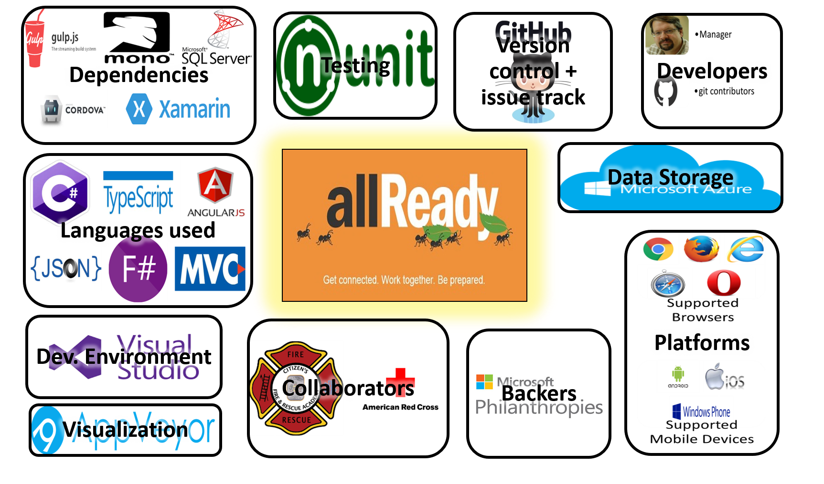
Context Diagram

Slide 17
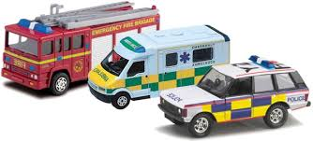

Stakeholders
Assessors, who check for compliance. Working in tandem with the allReady staff, relying on their results and handing requests and feedback.
Red Cross: (Director: @Jim McGowan)
Communicators, who create documents and training. Most of the documents are yet to be written, with the exception of the "getting started" tutorials for volunteers, which were written by allReady's core-developers
Github contributors
Developers, who create the system / Maintainers, who evolve and fix the system
Core developers: Staff skilled in management, knowledgeable in programming; mainly in Web, SQL, .NET, and AngularJS
Web team (Rohit, Elizabeth, Matt, Dan, Daniel, Glen, Connie)
Mobile team: (Jimmy, Dmitry, Parashuram, Louis, Guillaume)
Volunteering coders:
open-source contributors who volunteer to work on the improvement of allReady

Slide 18



Stakeholders
Production Engineers, who are responsible for the deployment environment.
Core developers: Staff skilled in management, supervising and directing the development of allReady; Seth Juarez (technical) Dmitry Lyalin (Senior Product Manager) Brady Gaster (Program Manager) Kirupa Chinnathambi (Senior Program Manager) Pranav Rastogi (Program Manager) Tarvis Lowdermilk (UX designer) Zlatko Knezevic (Program Manager) Jeff Fritz (Senior Program Manager)
Suppliers, who provide parts of the system. External companies which provide tools/ professional advisory/ software infrastructure Microsoft (contributing working platform, free server use and storage, and professional advisory and guidance) and various contributors
Support Staff, who help people to use the system. Technical staff, who help participants with hardware installation Volunteers with various helpful skills during the emergency of unexpected disasters Various others. For example, people who help raise readiness in a town by assisting in the installation of smoke detectors wherever the residents can't do so on their own

Slide 19

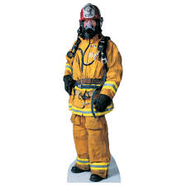
Stakeholders
System Administrators, who keep it running. Main manager (Richard Campbell) Advisors from Microsoft (backlog /pool / task-sharing management , operation monitoring and various logistics)
Testers, who verify that it works. Every programmer (core developer or contributor) is required to make his own test and make sure his addition / revision works well.
Users, who have to use the system directly. The organizations which physically deal with the disaster by aiding the locals, and the aided victims of the disastrous event. Examples for emergency services: Red Cross, Police, Fire-fighters... Examples for victims: people from towns caught in hurricane/earthquake/forest fires

Slide 20
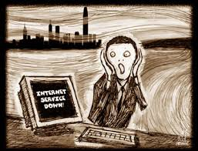
Challenges for allReady
In all disaster scenarios, the system has to be at least as reliable as "pen and paper". Some disasters may render crucial infrastructures inoperable, thus suitable solutions have to be prepared ahead of time;
for example, in case internet connectivity is weakened or lost at the disaster site, allReady's data transfer can be disrupted and resumed. If necessary, vehicles with wi-fi are brought to the site to allow a complete transfer.
Notes:
### “at least as reliable as ‘pen and paper’ “ is some what of a mantra – I heard it in more than 1 occasion…

Slide 21
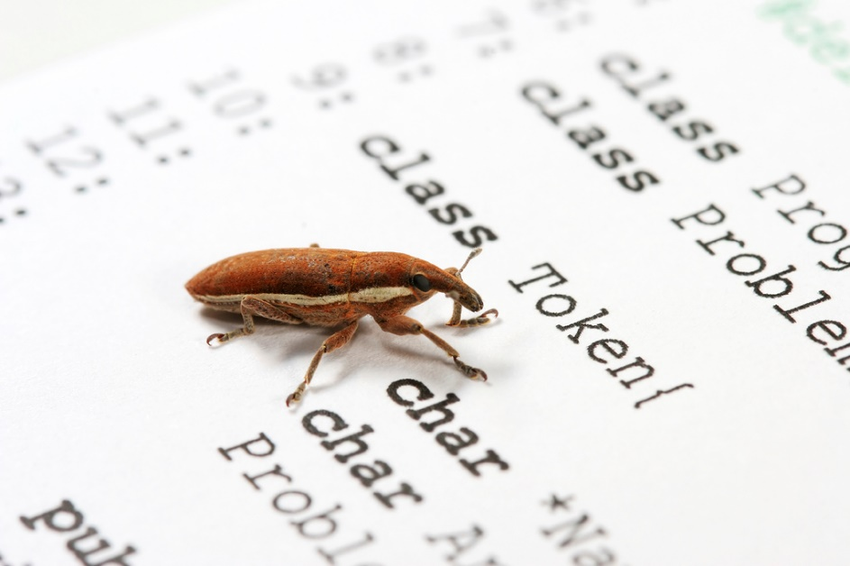
Challenges for allReady
Known bugs / issues:
Missing lots of documentation
Individual volunteers are unable to contact the admins unless they are part of a registered organization
Inconsistent naming in code
In-app map does not support Internet Explorer
Missing part in tutorial about SQL handling
Volunteers are not messaged / contacted yet in an ordered fashion
Notes:
*** Some typos

Slide 22
Architecture - This a place holder
Cloud services
The allReady web project is designed to be hosted in Microsoft Azure. The following services are used by this application when running in Azure:
App Service Web Apps: hosts the web application.
SQL Database: storage of relational data.
Storage: storage of uploaded BLOB data.
Authentication
Authentication of web site mobile app users leverages OAuth 2.0 with credentials from external authentication providers such as Facebook, Twitter, Google or Microsoft. Users can use their existing social media accounts to sign into the web site or mobile app. For more information, see Enabling authentication using external providers.
Cross-platform mobile app

Slide 23
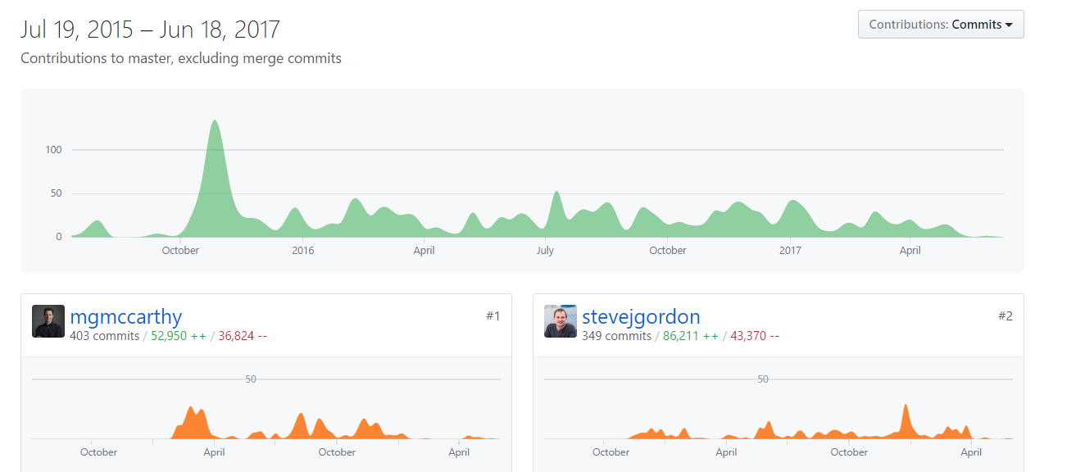
Active
Notes:
sub project of Humanitarian Toolbox.
Active project

Slide 24
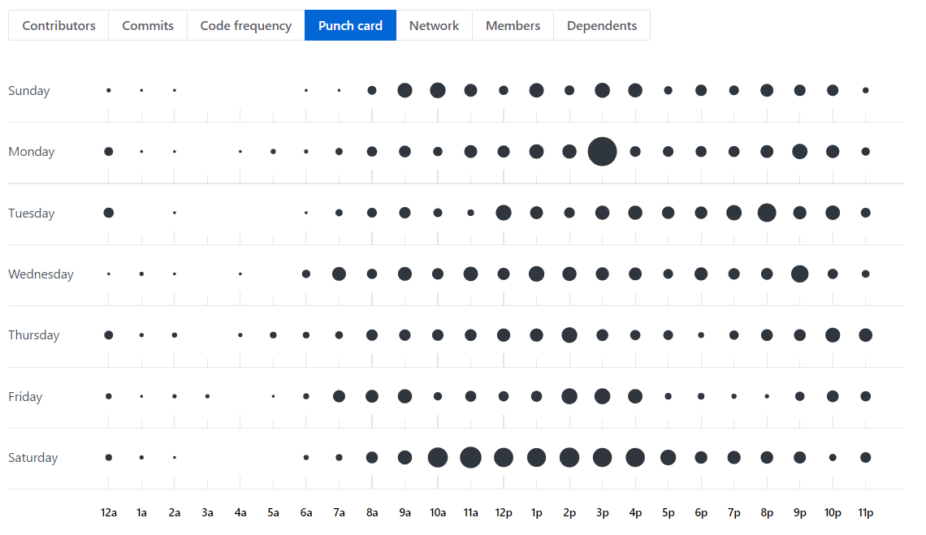
Active
Active
Notes:
Mostly on free time?

Slide 25
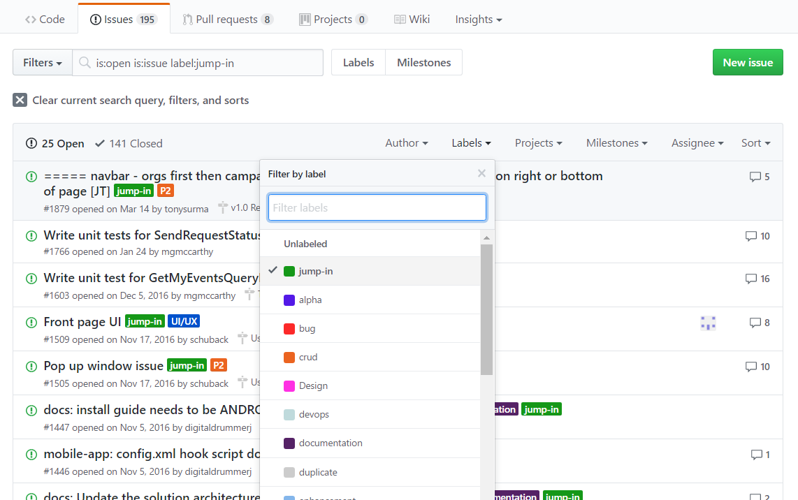
Active
Active
Notes:
Has special label for first time contributors for open source

Slide 26
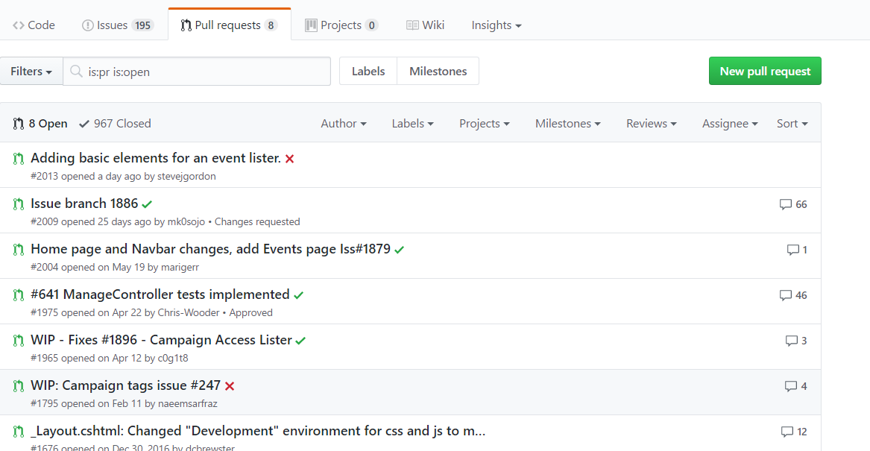
Active
Active
Notes:
Has pull requests

Slide 27
Changeability
Robustness over quick cycles of delivery
Standardization
How changing the DB is handled(using EF Core migrations)
Work with git
Testing UI changes (using Canopy)
Validating code correctness using ver 1000 unit tests.
CI using AppVeyor
Every pull request triggers a CI build (compile and run unit tests). This workflow gives more confidence that the code being merged to master isn't breaking anything.
Notes:
At list as pen & paper
Clear policies and guide lines for the above
It seems that the main reason to go with AppVeyor was the existing skillsets of contributors.

Slide 28
Evolution required Qualities
Requirement | How Met
1. The app must be easy to maintain cross-platform | The app is built using Xamarin – thus ensuring having maximum of shared code between multiple platforms
2. Avoid database update conflicts | Updates to the database are done using EF Core migrations. Before creating a pull request – it should be tested on a clean checkout of master branch.

Slide 29
Availability and Resilience
Requirement | How Met
1. There should be no single point of failure | The service is hosted By Azure which offers distributed and scalable services.
2. The service must be available on demand in times of need | To avoid the overhead of a full deployment chain – the service is hosted by Azure. This allows the service to be up constantly on one hand and avoiding the price of maintaining a server on the other hand (using auto-scale provided by Azure)
3. New contributions should not brake old features | There is a test suit that contains over 1000 tests. Contributors are encouraged run them and new ones for any new contribution. Every pull request triggers a CI build (compile and run unit tests). This gives more confidence that the code being merged to master isn't breaking anything.
4. The service should function also when there is no reliable internet connection | Messages are being using "post" _(rather than "get") for utilizing connection while available – even for a brief moment. In addition – the cellular network is being used as well for sending messages.

Slide 30
Summary
Guides & Getting involved
You can get involved in the following areas: Individual / Technology / Government Agency / Private Sector / NGO and Non-Profit / Other
Volunteer Sign-up page
Setup guide for developers SDKs supporting .Net / Linux / Mac OS X
Software instal Includes: General Install Steps Getting the Source Code Web Solution Running Test Cases Mobile Solution
Work with Git Assuming you've already installed Git, but don't know how to use it yet.
Notes:
allReady (& Humanitarian Toolbox) is a project dedicated for contributing to the community preparing for and while disasters situations using skills developers have.
challenges
that are uncommon for a software project (taking in consideration unstable environment like - no reliable internet connection)
while the mission of the software might be vital,
as well as common open source challenges (e.g. keeping quality of code base with over 100 contributors - all volunteers).
Facing those challenges
(taking advantage of SMS for communication, sending sparse messages when opportunity is available, push etc...)
and standardization solutions (detailed guides for contribution, unit & UI tests, CI).
Most of the time writing this chapter was spent on collecting information from varies sources and trying to put it together
did not find a self-contained source overviewing the project from an architecture / meta point of view I am not sure to what extent the data we have collected is correct / full.

Slide 31
Alternatives
BioSense Project
Caribbean Disaster Emergency Response Agency (CDERA)
CDC Widgets & Gadgets
Countermeasure Tracking System (CTS)
Federal Emergency Management Agency (FEMA)
FrontlineSMS
Global Disaster Information Network (GDIN)
Health Alert Network (HAN)
HHS Office of Preparedness & Medical Emergency Response
InSTEDD
Integrated Public Alert & Warning System (IPAWS) OPEN
National EMS Information System (NEMSIS)
Open ISES
Ready.Gov
Real-time Outbreak & Disease Surveillance (RODS)
Sahana Foundation Projects
Society for Public Health Education (SOPHE)
TriSano
Ushahidi
WebEMS
Wireless Information System for Emergency Responders (WISER)

